Slide 1

Technical Advisory Council (TAC) Overview

Slide 2
Academy Software Foundation Overview and Governance

Slide 3


An Open Source Foundation Developed in Partnership
The Academy Software Foundation provides a neutral forum for open source software developers in the motion picture and broader media industries to share resources and collaborate on technologies for image creation, visual effects, animation and sound.
Notes:
The Academy Software Foundation was developed in a partnership between the Academy of Motion Picture Arts and Sciences and the Linux Foundation, both partners bringing a unique blend of film industry knowledge and open source technical and organizational expertise to create a unique organization dedicated to accelerate software development and innovation in the motion picture industry.

Slide 4
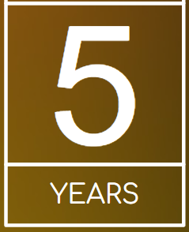

ASWF created
Open Source Forum 2022
Open Source Days 2024
01
01
First project
Open Source
Day 2019
Open Source Days 2020
Open Source Days 2021
March 10,2022
Rez
DPEL
Raw2ACES
August 10, 2018
Founding members:
Animal Logic
Autodesk
Blue Sky Studios
Cisco
DNEG
DreamWorks Animation
Epic Games
Foundry
Google Cloud
Intel
SideFX
The Walt Disney Studios
Weta Digital
Open Source
Days 2022
Open Source Days 2023
July 23-29 2024
Samsung
Caligra
October 23,2018
OpenVDB
New members:
Sony Pictures Entertainment
Warner Bros.
Blender Foundation
Visual Effects Society
July 29, 2019
OpenTimelineIO
Netflix
Amazon Web Services
Rodeo FX
MovieLabs
August 19-20 2020
Unity
Conductor Technologies
SMPTE
August 4-5 2021
MaterialX
Maxon
August 8-9, 2022
OpenFX
OpenAssetIO
Open Review
Initiative
Canonical
Khronos Group
July 25 -
August 7, 2023
OpenImageIO
Otoy
Bolt Graphics
Coreweave
Open Source
Forum 2025
12
17
Feb 13 2025
OpenAPV
Stability.ai
RaynaultVFX
April 16
2020
Open
Shading
Language
AMD
DockYard
10
08
Dec. 15
2020
Adobe
ETC
Jan. 28
2022
Wevr
Sept 13, 2019
Apple
Microsoft
Open Source
Forum 2024
05
15
February 8, 2019
OpenColorIO
13
Open Source
Forum 2023
Feb 22 2024
Mod Tech
Labs
11
18
02
Feb. 16 2023
HP
Framestore
06
09
03
May 1 2019
OpenEXR
OpenCue
NVIDIA
ftrack
Red Hat
07
16
14
Scitech
Council
Open source
Investigation
concludes
04
$1M/year
COVID
19
May
August
Oct
Feb
May
August
Oct
Feb
May
August
Jan
August
Feb
August
Feb
August
Feb
August
Feb
2018
2019
2020
2021
2022
2023
2024
Notes:
davidmorin@davidmorin.com

Slide 5



Membership
Premier
General
Associate
Notes:
Source: https://landscape.aswf.io/embed/embed.html?base-path=&key=aswf-member-company&headers=true&category-header=false&category-in-subcategory=false&title-uppercase=false&title-alignment=left&title-font-family=sans-serif&title-font-size=13&style=clean&bg-color=%232b8ca0&fg-color=%23ffffff&item-modal=false&item-name=false&size=lg&items-alignment=left

Slide 6
We’re a nonprofit, but not separately incorporated
The Academy Software Foundation is part of the the Linux Foundation and is not a separate legal entity
Therefore, the Academy Software Foundation Governing Board is not a corporate board of directors, and is not subject to corporate law statutes (e.g., those that govern fiduciary duties and how corporate boards of directors must operate)
The powers and duties of the Governing Board are set forth in the Academy Software Foundation Charter

Slide 7


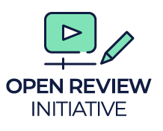














Academy Software Foundation
Structure
TAC
Technical Advisory Council
Governing Board
Outreach Committee
RMTC
DNA
rawtoaces
Continuous Integration platform

Slide 8
Working Groups
Machine Learning Working Group
A working group where the ML experts among our projects and members can meet, share expertise, better understand what ML-based tools are needed in our industry, and where helpful, spin off and guide ML-based open source projects aimed at addressing the specific needs of our film pipelines. #wg-ml
Dailies Notes Assistant (DNA)
The mission of the Project is to develop a tool designed to transcribe dailies meetings, analyze the content using an LLM, and provide a plugin system to integrate into production tracking software.
Rongotai Model Train Club (RMTC)
RMTC is a VFX-specific framework for simplifying the production and deployment of AI/ML models using well-tracked and rights-cleared datasets.

Slide 9




Working Groups

Slide 10
TAC Responsibilities

Slide 11
TAC Responsibilities
The TAC’s responsibilities include:
Setting an overall technical vision for the Academy Software Foundation
Approving new projects and working groups;
Overseeing the Project Lifecycle;
Enabling collaboration between projects and working groups;
Making recommendations to the Budget Committee for any resource needs;
Voting on other decisions that come before the TAC.
Additional responsibilities are described in Section 7 of the Academy Software Foundation Charter.

Slide 12
What the TAC is NOT responsible for
The TAC does not manage the day-to-day activities and operations of hosted projects and working groups, such as committer rights, release schedules, and roadmaps.
The TAC is not responsible for overseeing day-to-day operations of Academy Software Foundation. This is the responsibility of the foundation staff.
The TAC does not directly manage the overall budget for the Academy Software Foundation. The TAC makes resource recommendations to the Budget Committee and Governing Board, and provides feedback on the use of those resources.

Slide 13
TAC Operations

Slide 14
TAC Composition
The TAC voting members consist of:
One representative appointed from each Premier member; and
One representative appointed by the TSC of each project at the Adopted Stage
Up to three (3) annually TAC appointed industry representatives
See Section 7(b) of the Academy Software Foundation Charter for more information about composition.
You can change your representative at any time by making a request at members.aswf.io.

Slide 15
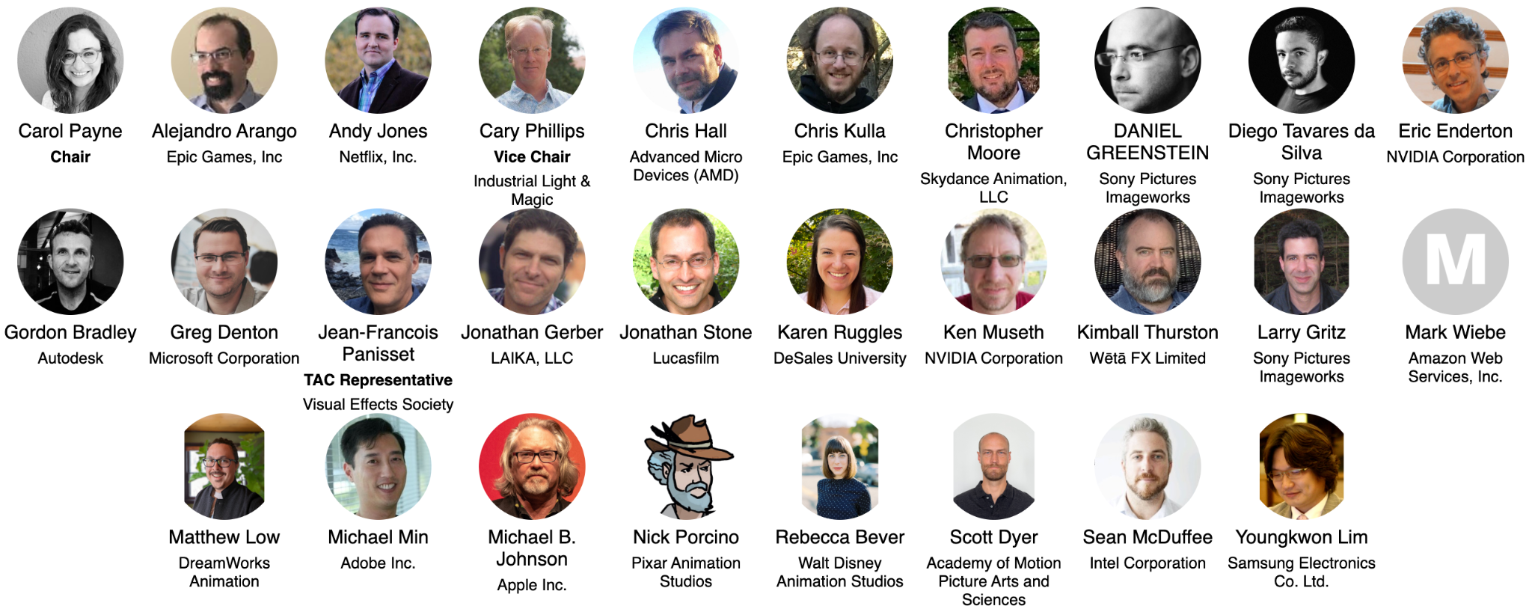
Technical Advisory Council (TAC)
Notes:
https://jmertic.github.io/committee-gallery/academy-software-foundation-tac

Slide 16
TAC Chairperson
Annually in December, the TAC will elect a chairperson to serve for the subsequent year.
Duties of the TAC Chairperson include:
Leading the strategy for setting an overall technical vision for the Academy Software Foundation
Preparing the agenda for and leading TAC meetings, with the support of the foundation staff ( generally meets with the staff on a regular basis to align on topics and priorities )
Serving as a voting member of the Governing Board to represent the TAC and larger technical communities.
Be a spokesperson for the TAC and larger technical community, as needed
See Section 7(f) of the Academy Software Foundation Charter for more information about the chairperson role.

Slide 17
TAC Meetings

Slide 18
Meeting Cadence
The TAC has virtual meetings, generally every other Wednesday. All meetings are public meetings unless specified otherwise.
Format for the meetings generally include short updates, and up to two larger topics ( such as an annual review of a project/working group, new project/working group proposal, larger discussion item, or special presentation )
Voting will often take place at each meeting
If you cannot attend a meeting and wish to have someone else represent you, please contact the foundation staff at members.aswf.io.
Additionally, the TAC has two hybrid Leadership Meetings sessions per year (at Open Source Forum in February and Open Source Days in August).
Governing Board representatives and a representative from each General Member are invited to Strategy Sessions.
In rare and exceptional circumstances (e.g., in an emergency situation), an additional ad hoc special meeting of the TAC may be convened.
To request a special meeting, please email your request to the Foundation Staff and TAC Chair, and they will decide whether a special meeting is necessary or the proposed agenda item can be discussed by email or at the next regular meeting.

Slide 19
How to propose an agenda item
Agenda for TAC meetings are managed at https://github.com/orgs/AcademySoftwareFoundation/projects/19
Propose a topic for a TAC meeting at https://github.com/AcademySoftwareFoundation/tac/issues/new/choose
Please submit your proposed agenda item at least 7 days prior to the meeting.
Please be patient. TAC meeting agendas are often quite full, and the length of the meeting only allows the time for two larger topics per meeting, so if your topic is more than a short topic it may not scheduled for the next meeting.

Slide 20
Proposing an agenda item (continued)
If we cannot accommodate your request in the upcoming meeting we may:
Wait until the following meeting to discuss the topic
Call a special meeting to discuss your topic, or
Refer the topic to the appropriate committee or task force of the TAC
We may ask you to provide slides 3 days before the meeting.

Slide 21
TAC Materials
Agendas for TAC meetings will be made available the day before the scheduled meeting
Past meeting notes can be found here.
No meeting of the TAC is recorded unless the TAC provides explicit consent to do so.

Slide 22
Discussion Channels
Relevant Mailing Lists
TAC Public List: tac@lists.aswf.io
TAC Private List: tac-private@lists.aswf.io
This list is ONLY for sensitive topics and voting
Project and Working Group Leads: technical-project-leads@lists.aswf.io
Slack Channel
You can join Academy Software Foundation slack here.
To join the TAC Slack channel, make a request at members.aswf.io.

Slide 23
Policies and Other Resources

Slide 24
Important Academy Software Foundation Policies and Resources
Academy Software Foundation Charter
Linux Foundation Antitrust Policy
Foundation GitHub repository with many other public facing policies and materials including…
Elections Process
Academy Software Foundation hosted project charters, which define each project’s intellectual property and licensing policies.
ASWF Landscape
High Level Overview

Slide 25
LFX Organization Dashboard
LFX Organization Dashboard provides access to key membership materials, including…
Member contacts, which you can change at any time ( look under ‘Users’ > and then under the ‘Key People’ tab )
Membership details ( look under ‘Membership’ > ‘Academy Software Foundation’ ), including…
Membership Overview Deck and High Level Overview Deck ( look under the ‘Resources’ tab )
Your fully executed membership agreement ( look under the ‘Membership’ tab )
Details on how to leverage membership benefits ( look under the ‘Benefits’ tab )
Insights on contributors from your organization ( look under the ‘Project Contributors’ tab )
ACTION: Request access to LFX Organizational Dashboard here.

Slide 26
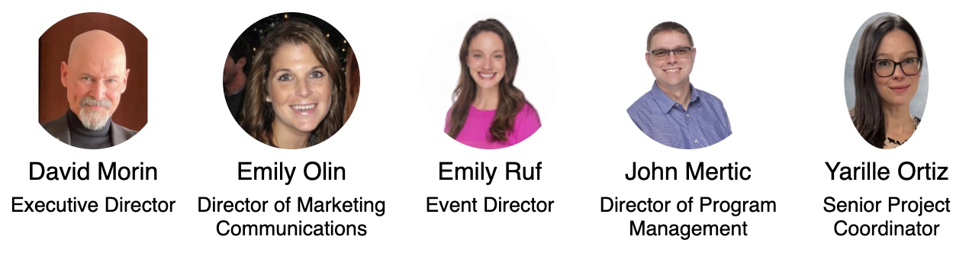
Foundation Staff
Contact the staff at members.aswf.io
Notes:
https://jmertic.github.io/committee-gallery/academy-software-foundation-staff_slidedeck_all

Slide 27
Who’s Who in the Academy Software Foundation
Academy Software Foundation Members
Staff: Academy Software Foundation Staff, Linux Foundation Leadership
Governing Board Members
Technical Advisory Council Members
Academy Software Foundation Project and Working Group Leads

Slide 28
Thank you!
If you have any questions, feel free to contact the staff at members.aswf.io.

